Slide 1
Project Management
Chapter 5
Systems Analysis and Design

Slide 2
Learning Objectives
Understand how projects are initiated and selected
Define a business problem and determine the feasibility of a proposed project
Plan a project by identifying activities and scheduling them
Understand how an alternative approach called agile development balances objectives to manage the analysis and design process
Manage team members and analysis and design activities so the project objectives are met while the project remains on schedule
Kendall & Kendall
3-<number>

Slide 3
Project Management Fundamentals
Project initiation
Determining project feasibility
Activity planning and control
Project scheduling
Managing systems analysis team members
Kendall & Kendall
3-<number>
Notes:
Project initiation – begins with problems or with opportunities for improvement in a business as the organization adapts to change.
Determining project feasibility – need to work with decision makers to determine if it is feasible.
Project scheduling – project activities are scheduled through the use of tools such as Gantt charts and PERT diagrams.
Planning and managing activities and team members – part of assuring the productivity of systems analysis team members is effectively managing scheduled activities.

Slide 4
Major Topics
Project Initiation
Determining feasibility
Determining resources
Activity planning and control
  Gantt charts
  PERT diagrams
Managing analysis and design activities
The Agile approach
Kendall & Kendall
3-<number>

Slide 5
Project Initiation
Problems in the organization
  Problems that lend themselves to systems solutions
Opportunities for improvement
  Caused through upgrading, altering, or installing new systems
Kendall & Kendall
3-<number>
Notes:
Both problems and opportunities can arise as the organization adapts to and copes with natural, evolutionary change.

Slide 6
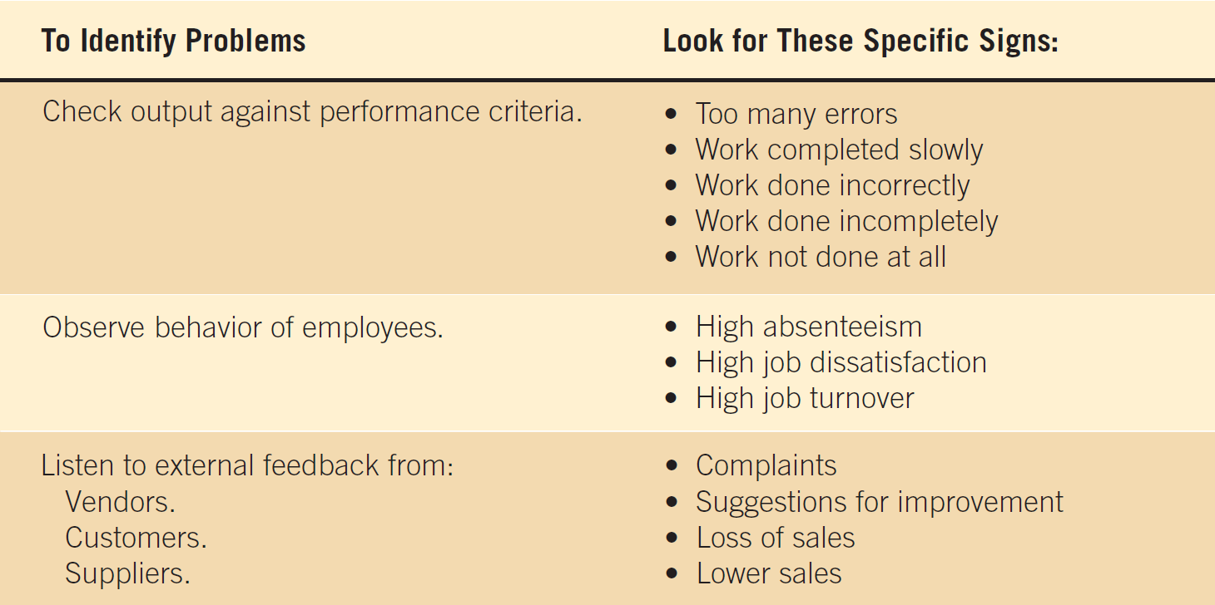
Figure 3.1 Checking output, observing employee behavior, and listening to feedback are all ways to help the analyst pinpoint systems problems and opportunities
Kendall & Kendall
3-<number>

Slide 7
Problem Definition
Problem statement
  Paragraph or two stating the problem or opportunity
Issues
  Independent pieces pertaining to the problem or opportunity
Objectives
  Goals that match the issues point-by-point
Requirements
  The things that must be accomplished along with the possible solutions, and constraints, that limit the development of the system
Kendall & Kendall
3-<number>
Notes:
Issues are the current situation, objectives are the desired situation.
Requirements may include security, usability, government requirements and so on.
Constraints might be budget restrictions or time limitations.

Slide 8
Problem Definition Steps
Find a number of points that may be included in one issue
State the objective
Determine the relative importance of the issues or objectives
Identify which objectives are most critical
Kendall & Kendall
3-<number>
Notes:
Before the problem definition is produced information is gathered from interviews, observations, and document analysis with the users. Major points are then identified as issues.
Once the issues are identified (current situation), objectives are stated (desired situation). Sometimes this may require follow-up interviews.
After the objectives are stated the relative importance of the issues or objectives is determined.
Due to constraints it is generally necessary to order the objectives to determine which are most critical.

Slide 9
Selection Of Projects
Backing from management
Appropriate timing of project commitment
Possibility of improving attainment of organizational goals
Practical in terms of resources for the system analyst and organization
Worthwhile project compared with other ways the organization could invest resources
Kendall & Kendall
3-<number>
Notes:
Backing from management – absolutely nothing can be accomplished without the endorsement of the people who eventually will foot the bill.
Appropriate timing of project commitment – can a time commitment be made for installation of new systems or improvement to existing ones.
Possibility of improving attainment of organizational goals – the project should put the organization on target, not deter it from its goals.
Practical in terms of resources for the system analyst and organization – is there expertise and resources to carry out the project.
Worthwhile project compared with other ways the organization could invest resources – when a business commits to one project it is committing resources that are unavailable for other projects.

Slide 10
Determining Feasibility
Defining objectives
Determining resources
  Operationally
  Technically
  Economically
Kendall & Kendall
3-<number>
Notes:
The feasibility study must be highly time compressed, encompassing several activities in a short span of time.

Slide 11
Defining Objectives
Many possible objectives exist including:
  Speeding up a process
  Streamlining a process
  Combining processes
  Reducing errors in input
  Reducing redundant storage
  Reducing redundant output
  Improving system and subsystem integration
Kendall & Kendall
3-<number>
Notes:
Improvements to systems can be defined as changes that will result in incremental but worthwhile benefits.

Slide 12
Feasibility Impact Grid (FIG)
A feasibility impact grid (FIG) is used to assess the impact of any improvements to the existing system
It can increase awareness of the impacts made on the achievement of corporate objectives
Kendall & Kendall
3-<number>
Notes:
FIG’s can be used for both process and corporate objectives analysis.

Slide 13
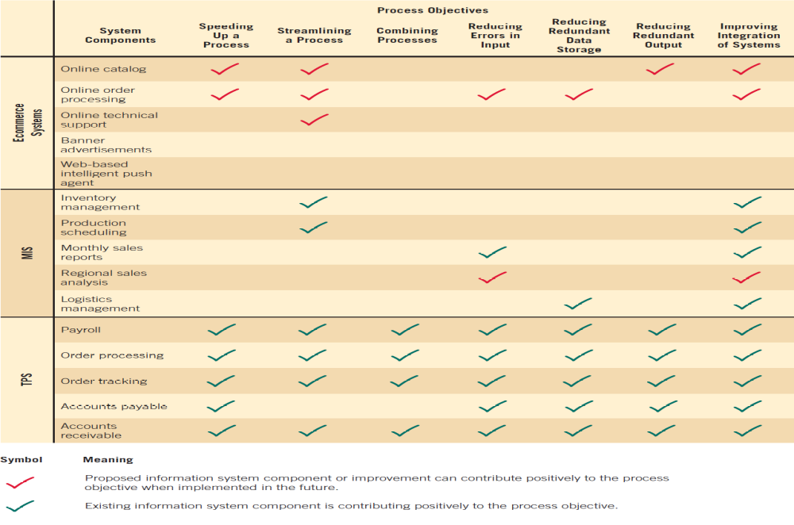
Figure 3.3 An analyst can use a feasibility impact grid to show how each system component affects process objectives
Kendall & Kendall
3-<number>
Notes:
Current or proposed systems are listed on the left.
Objectives are listed on the top.
Red arrows indicate a positive impact.
Green arrows indicate implementation.

Slide 14
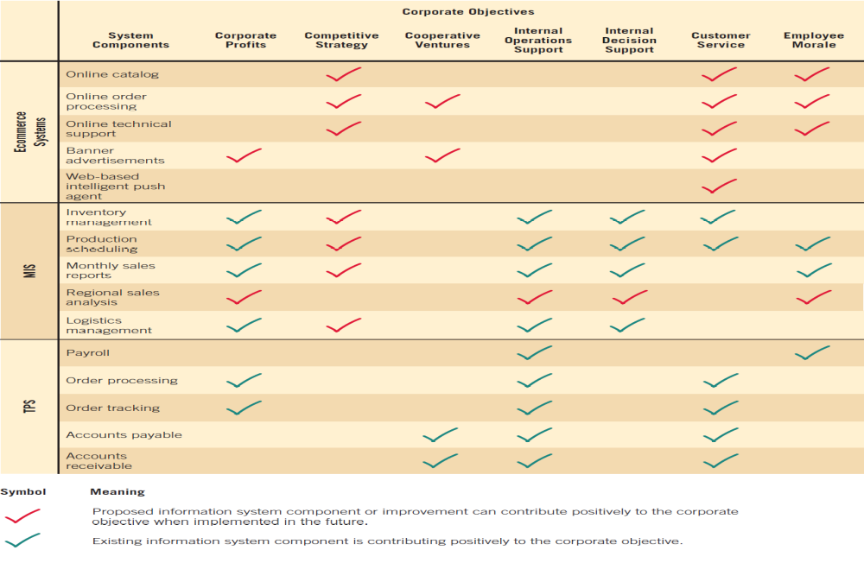
Figure 3.4 An analyst can use a feasibility impact grid to show how each system component affects corporate objectives
Kendall & Kendall
3-<number>
Notes:
By understanding process and corporate objectives, an analyst realizes why he or she is building systems and comprehends what the importance of designing efficient and effective systems might be.

Slide 15
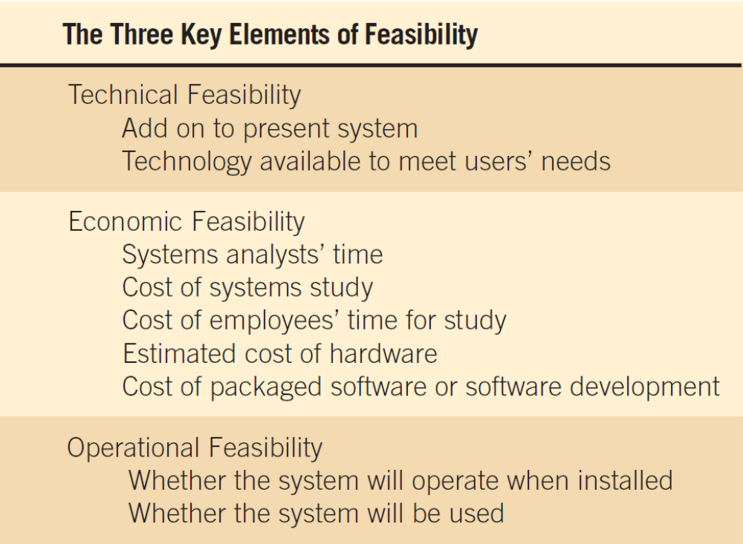
Figure 3.5 The three key elements of feasibility include technical, economic, and operational feasibility
Kendall & Kendall
3-<number>
Notes:
A project must be feasible in all three ways to merit further development.

Slide 16
Technical Feasibility
Can current technical resources be upgraded or added to in a manner that fulfills the request under consideration
If not, is there technology in existence that meets the specifications
Kendall & Kendall
3-<number>
Notes:
Sometimes add-0ns are costly and not worthwhile, because they meet needs inefficiently.

Slide 17
Economic Feasibility
Economic feasibility determines whether value of the investment exceeds the time and cost
Includes:
  Analyst and analyst team time
  Business employee time
  Hardware
  Software
  Software development
Kendall & Kendall
3-<number>
Notes:
If short-term costs are not overshadowed by long-term gains or produce no immediate reduction in operating costs, the system is not economically feasible.

Slide 18
Operational Feasibility
Operational feasibility determines if the human resources are available to operate the system once it has been installed
Users that do not want a new system may prevent it from becoming operationally feasible
Kendall & Kendall
3-<number>
Notes:
If users are satisfied with current system resistance to implementing a new system will be strong.
If users are dissatisfied with the current system and have expressed a need for change chances are that the new system will be used.

Slide 19
Activity Planning And Control
Planning includes:
  Selecting a systems analysis team
  Estimating time required to complete each task
  Scheduling the project
Control includes:
  Comparing the plan for the project with its actual evolution
  Taking appropriate action to expedite or reschedule activities
Kendall & Kendall
3-<number>

Slide 20
Estimating Time
Project is broken down into phases
Further project is broken down into tasks or activities
Finally project is broken down into steps or even smaller units
Time is estimated for each task or activity
Most likely, pessimistic, and optimistic estimates for time may be used
Kendall & Kendall
3-<number>

Slide 21
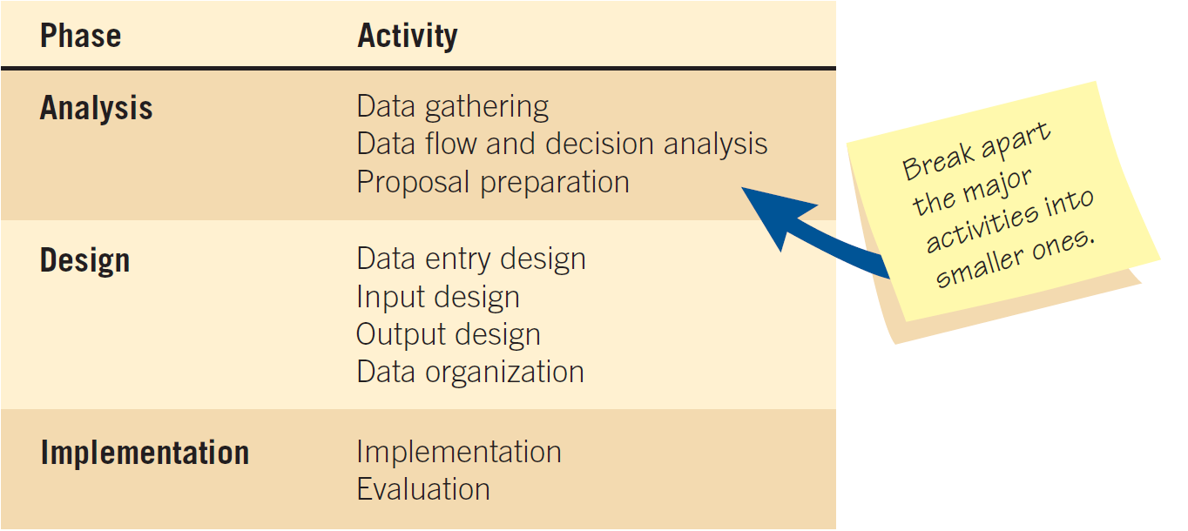
Figure 3.6 Beginning to plan a project by breaking it into three major activities
Kendall & Kendall
3-<number>

Slide 22
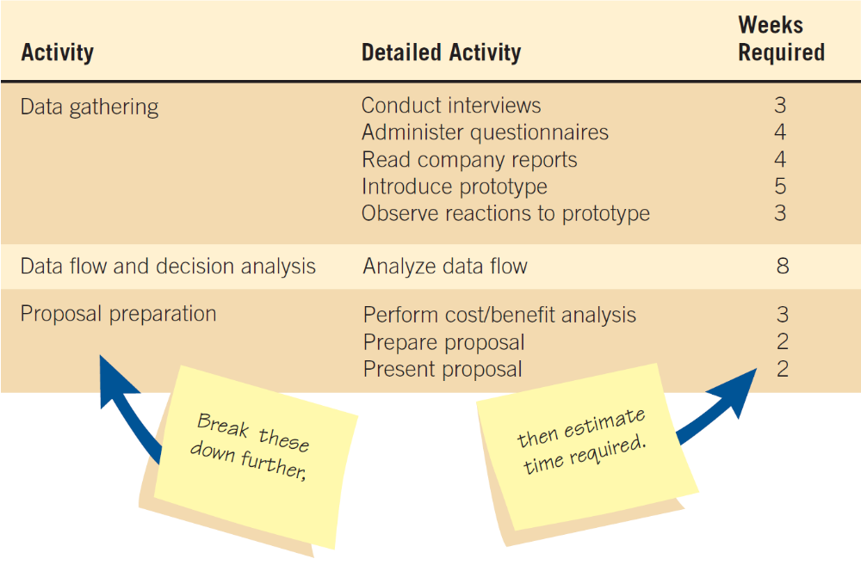
Figure 3.7 Refining the planning and scheduling of analysis activities by adding detailed tasks and establishing the time required to complete the tasks
Kendall & Kendall
3-<number>

Slide 23
Project Scheduling
Gantt Charts
  Simple
  Lends itself to end user communication
  Drawn to scale
PERT diagrams
  Useful when activities can be done in parallel
Kendall & Kendall
3-<number>

Slide 24
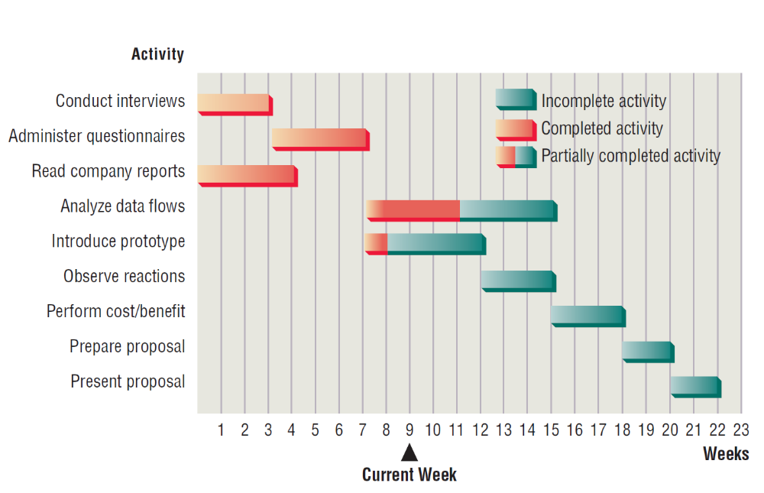
Figure 3.8 Using a two-dimensional Gantt chart for planning activities that can be accomplished in parallel
Kendall & Kendall
3-<number>

Slide 25
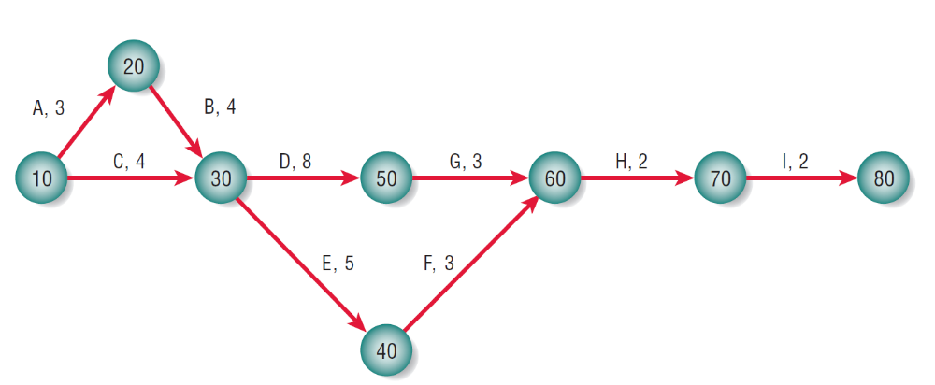
Figure 3.12 A completed PERT diagram for the analysis phase of a systems project
Kendall & Kendall
3-<number>

Slide 26
PERT Diagram Advantages
Easy identification of the order of precedence
Easy identification of the critical path and thus critical activities
Easy determination of slack time
Kendall & Kendall
3-<number>

Slide 27
Timeboxing
Timeboxing sets an absolute due date for project delivery
The most critical features are developed first and implemented by the due date
Other features are added later
Kendall & Kendall
3-<number>

Slide 28
Project Due Dates
Estimating models
  Costar
  Construx
Function point analysis
  Helps the analyst quantitatively estimate the overall length of software development efforts
Kendall & Kendall
3-<number>

Slide 29
Function Point Analysis
Count components
Rate each component’s complexity
Assign complexity numbers
Arrive at a subtotal
Multiply by adjustment factor
Kendall & Kendall
3-<number>

Slide 30
Based on Five Main Components of Computer Systems
  External inputs
  External outputs
  External queries
  Internal logical files
  External interface files
Kendall & Kendall
3-<number>
Notes:
External input – can be data from another application or even data entered on an input screen
External output – usually derived variables, calculated within the system that transfer to another system or prepare a report.
External queries – actions that retrieve data from internal files or databases but not change them.
Internal logical files – clusters of logically identifiable data that are stored entirely within the system.
External interface files – groups of logically related data maintained by applications outside the system and are used for reference purposes only.

Slide 31
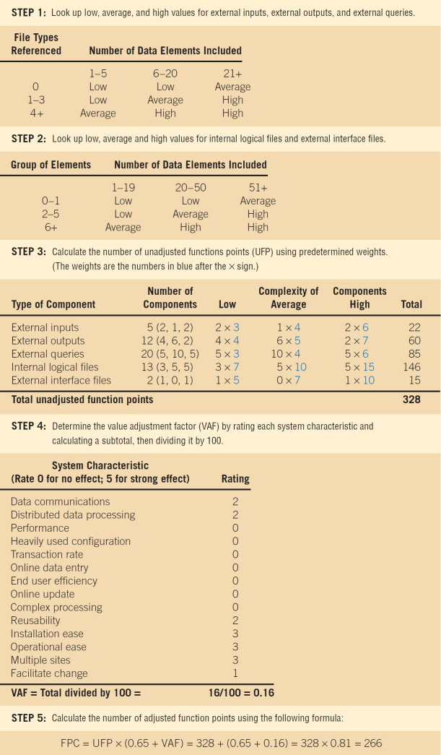
Figure 3.15 Function point counts can be accomplished in five steps
Kendall & Kendall
3-<number>

Slide 32
Staffing Requirements
Choice of software can influence the amount of effort that goes into system development
It is not true that the more people assigned to a task, the faster it will get done
Kendall & Kendall
3-<number>
Notes:
A rule of thumb to estimate person-months:
Number of person months = 1.4 x (number of lines of code/1,000)
A rule of thumb to calculate months scheduled:
Scheduled months = 3 * (person months) ^{1/3}

Slide 33
Managing Risk
30 percent of all projects succeed
20 percent fail
50 percent finish, but are either late, over budget, or offer fewer features than originally promised
Kendall & Kendall
3-<number>

Slide 34
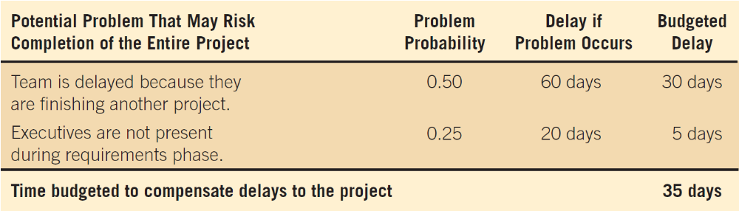
Figure 3.16 Calculating the extra time required to ensure that a project is completed on time
Kendall & Kendall
3-<number>
Notes:
If the project manager carefully things about scenarios that would cause potential problems and calculates the expected value of all delays, they would be able to add additional time as a buffer to protect against the entire project failing.

Slide 35
Managing Analysis and Design Activities
Team management
  Assembling a team
  Team communication strategies
  Project productivity goals
  Team member motivation
Kendall & Kendall
3-<number>

Slide 36
Assembling a Team
Shared value of team work
Good work ethic
Honesty
Competency
Readiness to take on leadership based on expertise
Motivation
Enthusiasm for the project
Trust of teammates
Kendall & Kendall
3-<number>
Notes:
Experience – this could mean code is developed five times faster
Motivation – select good people at the outset
Enthusiasm - Not only enthusiasm, but imagination and the ability to communicate with different kinds of people
Trust – people may have different work styles, but they all need to agree to work together toward a common goal.

Slide 37
Communication Strategies
Teams often have two leaders:
  One who leads members to accomplish tasks
  One concerned with social relationships
The systems analyst must manage:
  Team members
  Their activities
  Their time and resources
Kendall & Kendall
3-<number>

Slide 38
Project Productivity Goals and Motivation
Successful projects require that reasonable productivity goals for tangible outputs and process activities be set
Goal-setting helps to motivate team members
Kendall & Kendall
3-<number>

Slide 39
Ecommerce Project Management
Ecommerce and traditional software project management differences:
  The data used by ecommerce systems is scattered across the organization
  Ecommerce systems need a staff with a wide variety of skills
  Partnerships must be built externally and internally well ahead of implementation
  Security is of utmost importance
Kendall & Kendall
3-<number>

Slide 40
Project Failures
Project failures may be prevented by:
  Training
  Experience
  Learning why other projects have failed
Project charter
  Describes in a written document what the expected results of the systems project are and the time frame for delivery
Kendall & Kendall
3-<number>

Slide 41
Agile Development
An innovative philosophy and methodology comprised of systems development practices, techniques, values, and principles intended for use in developing systems in a dynamic way
Kendall & Kendall
3-<number>

Slide 42
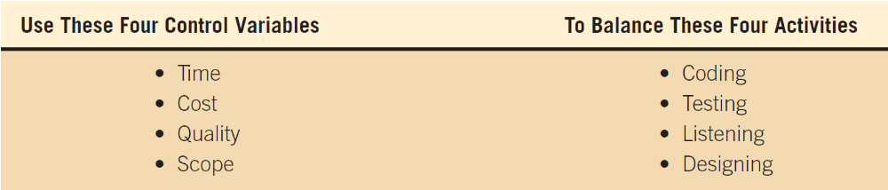
Figure 3.17 The analyst can control the time, cost, quality, and scope of the project to balance the activities
Kendall & Kendall
3-<number>

Slide 43
Agile Core Practices and Roles of the Agile Approach
There are four Agile practices:
  A short release time
  Working a 40-hour week
  Having an onsite customer
  Pair programming
Kendall & Kendall
3-<number>

Slide 44
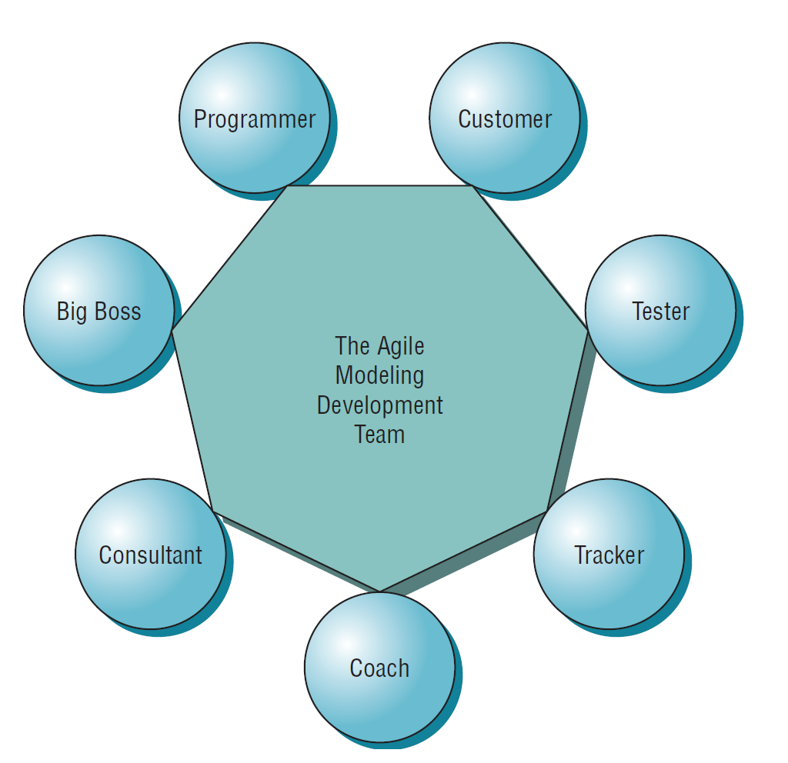
Figure 3.19 Roles in the Agile Development process include members from inside of the development team as well as at least one onsite customer
Kendall & Kendall
3-<number>

Slide 45
The Planning Game
The planning game defines rules to help formulate the development team and customer relationship
Limits uncertainty
Two players: the development team and the business customer
Customers decide what to tackle first
Kendall & Kendall
3-<number>

Slide 46
Development Process for an Agile Project
Agile projects are interactive and incremental
The five Stages of Agile development are:
  Exploration
  Planning
  Iterations to the first release
  Productionizing
  Maintenance
Kendall & Kendall
3-<number>

Slide 47
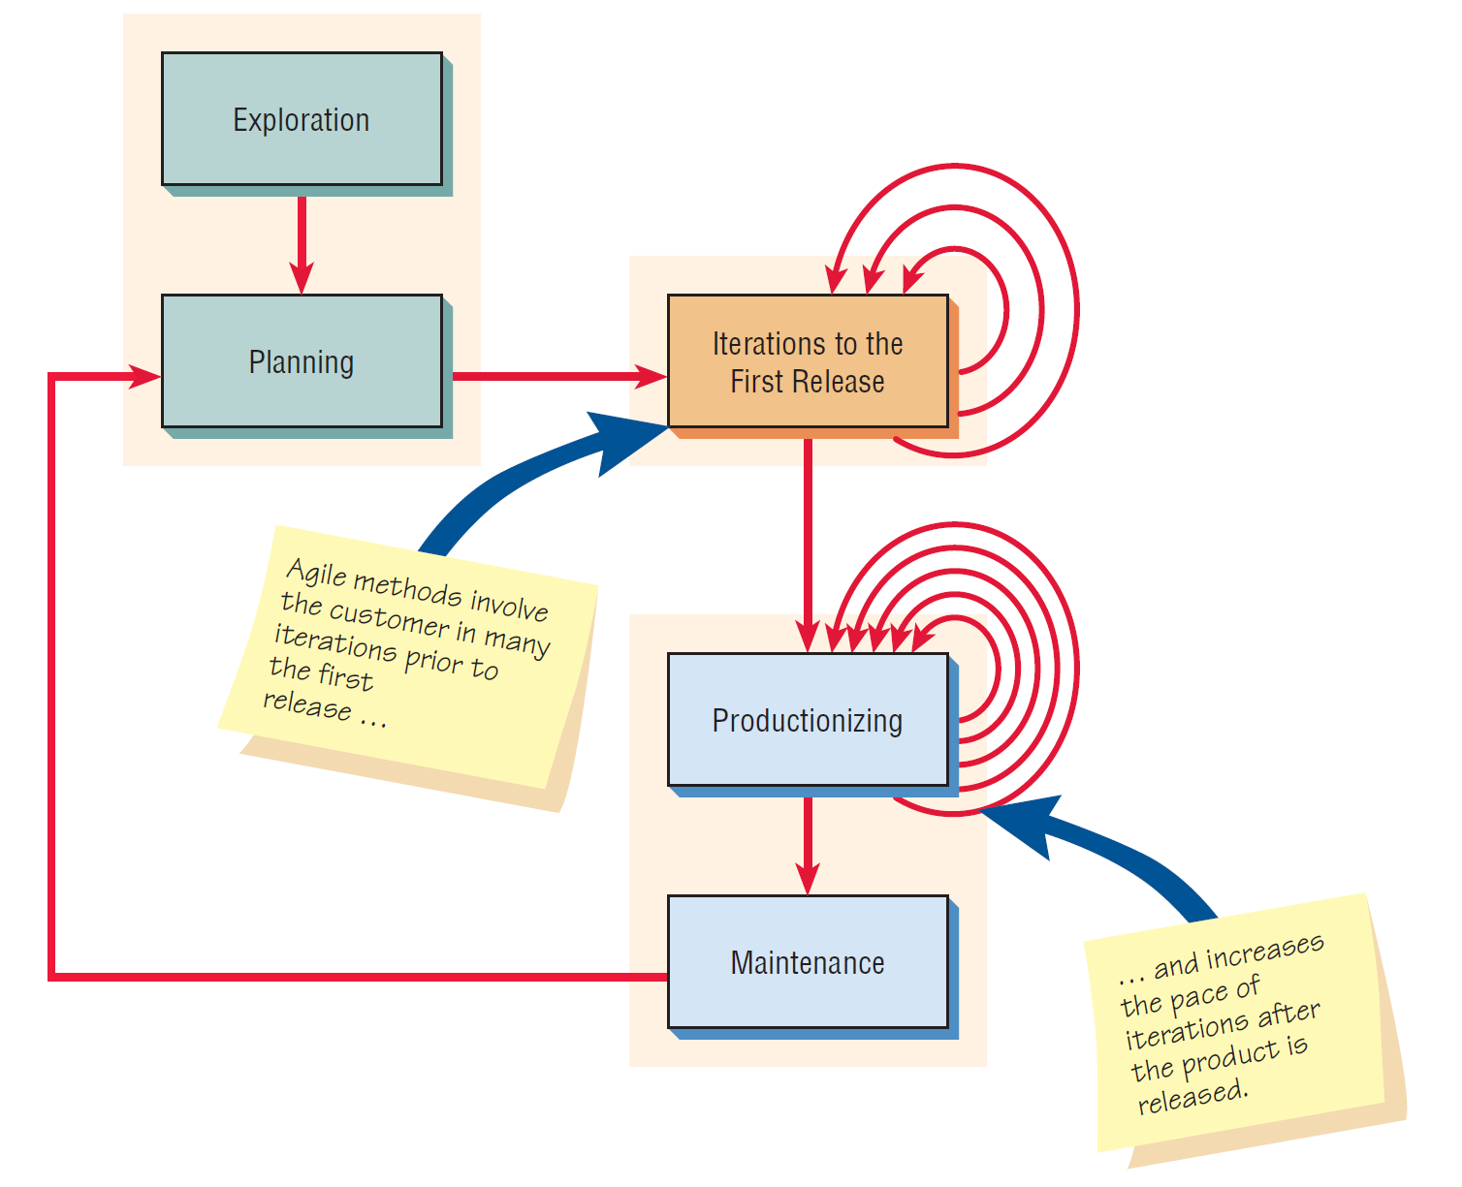
Figure 3.21 The five stages of the agile modeling development process show that frequent iterations are essential to successful system development
Kendall & Kendall
3-<number>

Slide 48
Summary
Project management fundamentals
  Project initiation
  Determining project feasibility
  Activity planning and control
  Project scheduling
  Managing systems analysis team members
Problem definition
  Issues of the present system
  The objective for each issue
  The requirements that must be included in all proposed systems
Kendall & Kendall
3-<number>

Slide 49
Summary (Continued)
Project selection
  Backed by management
  Commitment of resources
  Attains goals
  Practical
  Important
Feasibility
  Operational
  Technical
  Economic
Kendall & Kendall
3-<number>

Slide 50
Summary (Continued)
Project planning
  Gantt charts
  PERT
  Function point analysis
Team management
Ecommerce projects
The Agile approach
Kendall & Kendall
3-<number>

